Slide 1
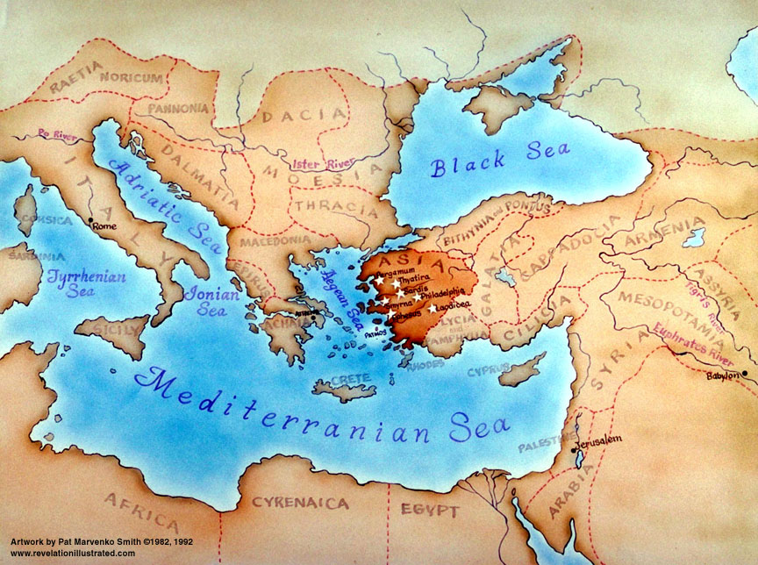
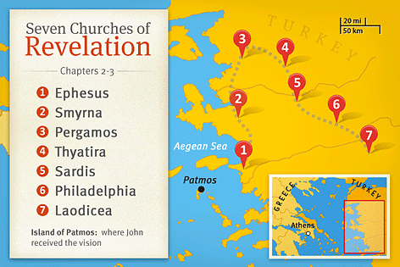

Slide 2
Revelation 2:1-7

Slide 3
2 “To the angel of the church in Ephesus write: ‘The words of him who holds the seven stars in his right hand, who walks among the seven golden lampstands.
² “ ‘I know your works, your toil and your patient endurance, and how you cannot bear with those who are evil, but have tested those who call themselves apostles and are not, and found them to be false. ³ I know you are enduring patiently and bearing up for my name’s sake, and you have not grown weary. ⁴ But I have this against you, that you have abandoned the love you had at first.

Slide 4
⁵ Remember therefore from where you have fallen; repent, and do the works you did at first. If not, I will come to you and remove your lampstand from its place, unless you repent. ⁶ Yet this you have: you hate the works of the Nicolaitans, which I also hate. ⁷ He who has an ear, let him hear what the Spirit says to the churches. To the one who conquers I will grant to eat of the tree of life, which is in the paradise of God.’

Slide 5
The 7 letters to the 7 churches in Asia (Turkey)
Each letter ends with a promise of eternal life in Jesus Christ
About being witnesses for Jesus in an anti-Christian culture
The structure of the letters
1. A command to write to an angel of a church
2. Christ describes Himself
3. He congratulates the church for its good works (if any)
4. An accusation is leveled at the church because of some sin
5. Warned to change their ways (judgment / encouragement)
6. Do you accept this or deny it????
7. A promise to those who conquer the problem

Slide 6
The 7 letters to the 7 churches in Asia (Turkey)
Each letter ends with a promise of eternal life in Jesus Christ
About being witnesses for Jesus in an anti-Christian culture
The letter to the Church at Ephesus
1. A command to write to the angel of the church of Ephesus
2. Christ describes Himself
3. He congratulates the church for its good works (if any)
4. An accusation is leveled at the church because of some sin
5. Warned to change their ways (judgment / encouragement)
6. Do you accept this or deny it????
7. A promise to those who conquer the problem

Slide 7
The 7 letters to the 7 churches in Asia (Turkey)
Each letter ends with a promise of eternal life in Jesus Christ
About being witnesses for Jesus in an anti-Christian culture
The letter to the Church at Ephesus
1. A command to write to the angel of the church of Ephesus
2. Christ holds 7 stars in His right hand & walks among the 7 lampstands
There is a spiritual dimension to the church.
Christ is the source of the light
He is very aware of everything a church does
3. He congratulates the church for its good works (if any)
4. An accusation is leveled at the church because of some sin
5. Warned to change their ways (judgment / encouragement)
6. Do you accept this or deny it????
7. A promise to those who conquer the problem

Slide 8
1. A command to write to the angel of the church of Ephesus
2. Christ holds 7 stars in His right hand & walks among the 7 lampstands
There is a spiritual dimension to the church.
Christ is the source of the light
He is very aware of everything a church does
3. He congratulates the church for its good works
They toil / labour / work hard for the Kingdom of God
Patiently endure hardship and persecution
Intolerance of false teaching
4. An accusation is leveled at the church because of some sin
5. Warned to change their ways (judgment / encouragement)
6. Do you accept this or deny it????
7. A promise to those who conquer the problem

Slide 9
1. A command to write to the angel of the church of Ephesus
2. Christ holds 7 stars in His right hand & walks among the 7 lampstands
There is a spiritual dimension to the church.
Christ is the source of the light
He is very aware of everything a church does
3. He congratulates the church for its good works
They toil / labour / work hard for the Kingdom of God
Patiently endure hardship and persecution
Intolerance of false teaching
4. An accusation is leveled at the church because of some sin
They have abandoned the love that they had at first
Truth and love must go together
5. Warned to change their ways (judgment / encouragement)
6. Do you accept this or deny it????
7. A promise to those who conquer the problem

Slide 10
1. A command to write to the angel of the church of Ephesus
2. Christ holds 7 stars in His right hand & walks among the 7 lampstands
There is a spiritual dimension to the church.
Christ is the source of the light
He is very aware of everything a church does
3. He congratulates the church for its good works
They toil / labour / work hard for the Kingdom of God
Patiently endure hardship and persecution
Intolerance of false teaching
4. They have abandoned the love that they had at first
Truth and love must go together
5. Repent – Love like you used to love
If we don’t love, we’re not His church
6. Do you accept this or deny it????
7. A promise to those who conquer the problem

Slide 11
1. A command to write to the angel of the church of Ephesus
2. Christ holds 7 stars in His right hand & walks among the 7 lampstands
There is a spiritual dimension to the church.
Christ is the source of the light
He is very aware of everything a church does
3. He congratulates the church for its good works
They toil / labour / work hard for the Kingdom of God
Patiently endure hardship and persecution
Intolerance of false teaching
4. They have abandoned the love that they had at first
Truth and love must go together
5. Repent – Love like you used to love
If we don’t love, we’re not His church
6. Do you accept this or deny it????
7. A promise to those who conquer the problem

Slide 12
1. A command to write to the angel of the church of Ephesus
2. Christ holds 7 stars in His right hand & walks among the 7 lampstands
There is a spiritual dimension to the church.
Christ is the source of the light
He is very aware of everything a church does
3. He congratulates the church for its good works
They toil / labour / work hard for the Kingdom of God
Patiently endure hardship and persecution
Intolerance of false teaching
4. They have abandoned the love that they had at first
Truth and love must go together
5. Repent – Love like you used to love
If we don’t love, we’re not His church
6. Do you accept this or deny it????
7. Love like you used to love, & I will give you eternal life
Truth and Love must go together

